Slide 1
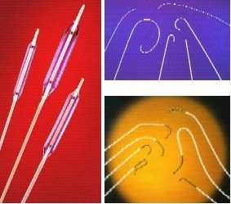
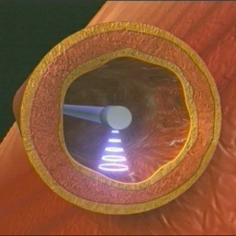
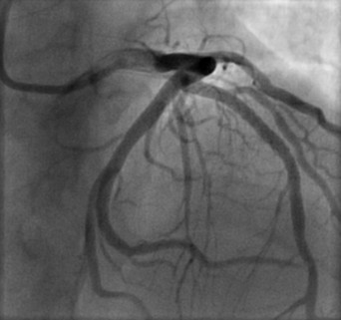
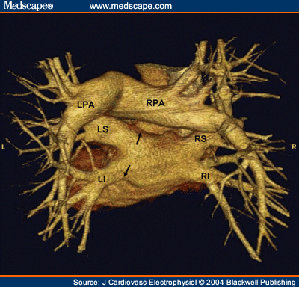
_{Cath Lab Essentials:} _{“worst case scenario”}
Pranav M. Patel, MD, FACC, FSCAI
Chief, Division of Cardiology
Director, Cardiac Cath Lab & CCU
University of California, Irvine
Division of Cardiology
Notes:
Talk about Infraredx lipiscan technology and its us in coronary artery imaging. More specifically its use in imaging cholesterol plaque with coronary walls
Today I am going to speak about PAD, and the guidelines that are available to us (especially in the field of IM and cardiology) regarding the diagnosis and management of this disease entity
Up to 20-25% of all patients with CAD also have PAD. Both disease entities have the same risk factors and have similar treatment modalities, and so therefore, this is why we are seeing PAD becoming more relevant in the practice of cardiology.
Today I will be concentrating on LE PAD, but please note that PAD encompases LE/UE PAD, RAS, mesenteric artery disease, carotid artery disease, AAA.

Slide 2
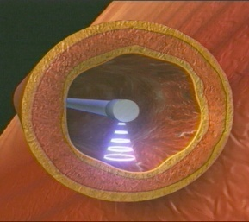
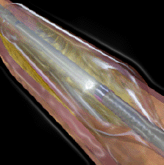
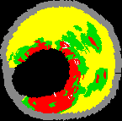
Acknowledgments
No financial disclosures
Notes:
While I was putting this talk together I began to think about why we developed guidelines, the role these guidelines play in helping us to manage our patients and why we have various medical organizations such as the AHA.
Well is partly because these things help us to practice medicine in a safe and responsible manner

Slide 3
Case
56 yo man with hyperlipidemia. Very active (surfer). Now with DOE and fatigue.
Exercise stress test with good functional capacity, but VT with exercise (56 beats) that resolved spontaneously.
Taken to Cath Lab.
Serum blood test within normal
Heparin used for anticoagulation.

Slide 4
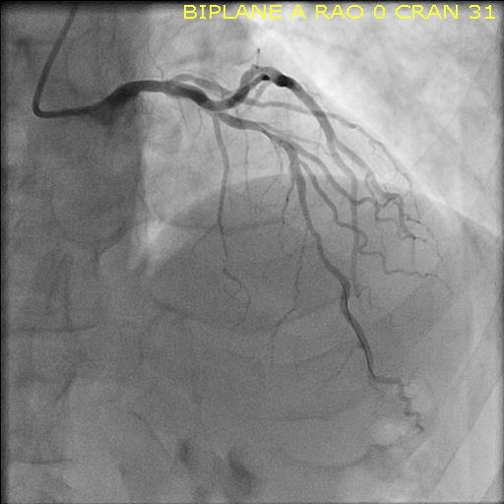
FFR 0.72 after mid-distal lesion and 0.81 after mid lesion. Heparin with ACT 280

Slide 5
2nd overlapping (more proximal stent) as FFR still significant

Slide 6
Post dilatation…followed by angiography

Slide 7
What’s do we do now?

Slide 8
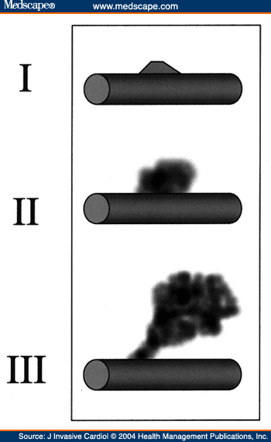
Ellis classification scheme for coronary artery perforations.
Types I and II are "contained" perforations, whereas
Type III is a "free" perforation with continuous extravasation of contrast. A more benign Type III "cavity spilling" perforation is also described in which contrast spills directly into an anatomic circulatory chamber

Slide 9
Nursing perspective
Is the patient hemodynamically stable (BP, HR)
IVF with NS, consider inotropic support
Anti coagulation (Should we reverse?..and how?)
Heparin→Protamine /GP IIbIIIa-Platelet transfusion
IABP support may be needed/possible CPR
Patient may require pericardiocentesis/ECHO notified
Blood transfusion needed?
CT surgeons notified/anesthesiology made aware

Slide 10
Technologist perspective
Prolonged balloon inflation
Consider possible pericardiocentesis
Will an IABP needed? Contralateral accesss
CPR-are the team ready to perform CPR, ECHO or intubation (Image intensifier and cath table ready)
Will a stent be needed?...is it a covered stent?
>2mm vessel → covered stent; distal perforation or small vessel < 2mm-coil embolization
What sheath size and guide catheter size needed for covered stent?

Slide 11
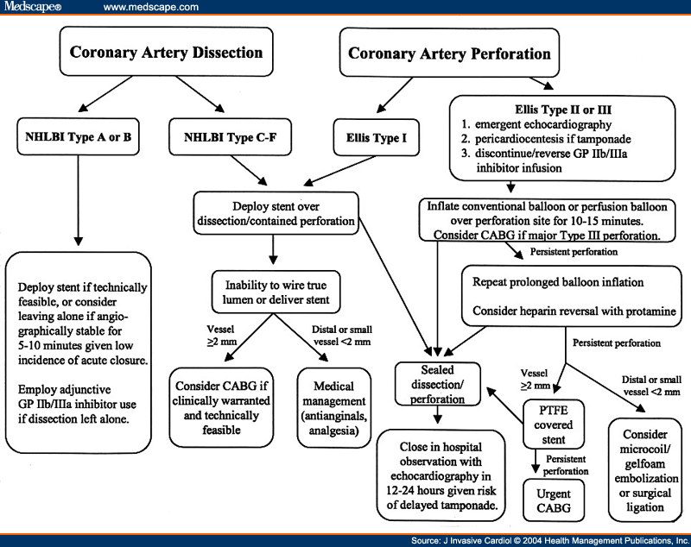

Slide 12
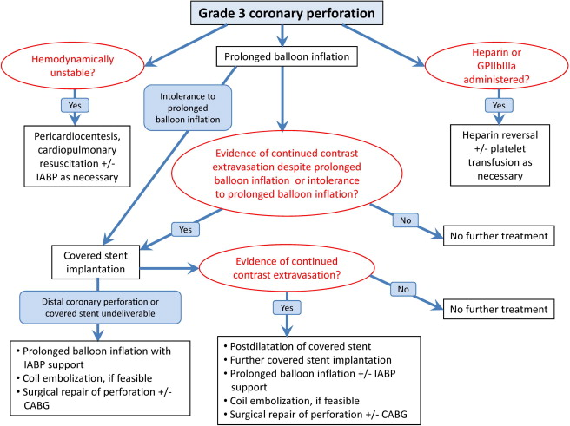

Slide 14
Prolonged balloon inflation…but then NSVT

Slide 15
Covered Stent deployment after chnging sheaths and guide catheter

Slide 16
Perforation sealed

Slide 17
Final images

Slide 18
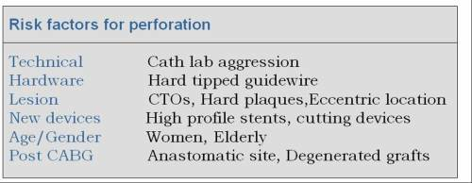

Slide 19
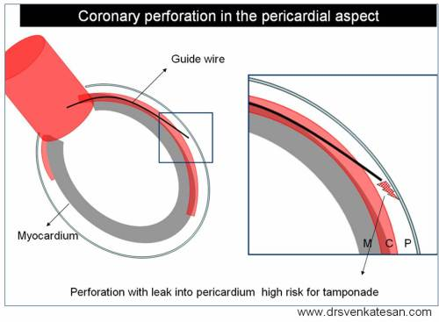
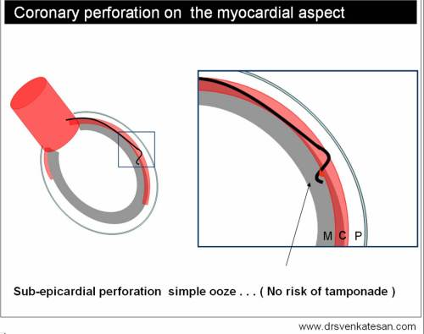
Coronary perforation

Slide 20
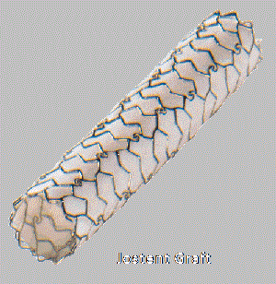
http://drsvenkatesan.com/
Polytetra fluro ethylene (PTFE)( Jostent )

Slide 21
End – questions?
Thanks!

